Slide 1

复习指导 一般过去时态和现在完成时态

Slide 2

Welcome
The Past Tense
一般过去时态
一般过去时态

Slide 3
一般过去时态:
概念:
1. 表示过去某个时间发生的动作或存在的状态。
2.过去时间里，习惯性、经常性的动作、行为。
结构：
主语+动词过去式
I was in Shanghai last year.
I went to the zoo yesterday.

Slide 4

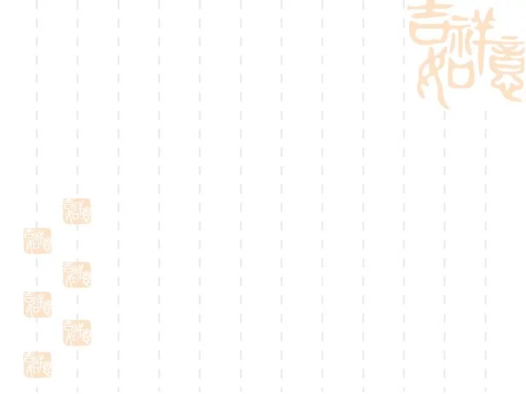
一般过去时态的标志词
1.yesterday ,the day before yesterday,….
2.last week / month / year
3.just now ≠ now
4. …ago
5. in 1989
6. in the past
7.When he was 5=at the age of 5

Slide 5

规则动词过去式的构成
1、一般情况下，加 –ed，ask -- asked help -- helped
2、结尾是“e”的词加 –d ,dance -- danced love -- loved
3、重读闭音节词且末尾只有一个辅音字母的，先双写这个辅音字母，再加 –ed. stop -- stopped regret -- regretted
4、以辅音字母加 y 结尾的词，改 y 为 i，再加 -ed。
carry -- carried study -- studied

Slide 6


prefer
plan
try
stay
wait
move
study
listen
enjoy
看看他们属于哪一类？
enjoyed
listened
studied
planned
waited
tried
preferred
stayed
moved
C.变y为i+ed
D.双写末尾字母+ed
A.直接+ed
B.直接+d

Slide 7

不规则动词过去式
see-saw
go-went
have-had
run-ran
get-got
put-put
say-said
tell-told
make-made
come-came
take-took
give-gave
meet-met
lose-lost
know-knew
eat-ate
swim-swam
draw-drew
grow-grew
leave-left
keep-kept
hear-heard
wear-wore
find-found
write-wrote
break-broke
win-won
fly-flew
drink-drank
begin-began
teach-taught
think-
thought
bring-
brought
buy-bought
feed-fed
lead-led

Slide 8

Welcome
The Present Perfect Tense
现在完成时态
现在完成时态

Slide 9

现在完成时态
构成：have/has +动词的过去分词
用 法
时间状语
I can’t find my pen. I have lost it.
1.表示过去发生的动作对现在造成的影响或结果。
already; yet; ever; never; just; before;
since;
for ；
how long;
in the last/past few years;
three times
so far; up to now（到目前为止）
过去影响现在
Have you finished it yet ?
过去
持续
到现在
2.表示从过去某一时刻开始一直持续到现在的动作或状态,和表示延续的时间状语连用。表示持续动作或状态的动词多是延续性动词。
He has worked here for a year.
I have taught in this school since 1999 .
两“去”
He has been to Beijing many times.
have/has been to（曾经去过，回来了）
have/has gone to（去…里，没回来）
She isn’t here. She has gone to Beijing.

Slide 10
规则动词过去分词的变化：
变化规则 | 动词原形 | 过去分词
一般动词词尾加 -ed | walk listen | walked listened
以字母e结尾的动词后加-d | live, notice decide | lived, noticed decided
以辅音字母加y结尾的动词,变y为i,再加-ed | hurry, carry, study, | hurried, carried, studied
结尾只有一个辅音字母的重读闭音节,先双写该辅音字母,再加-ed | stop, step | stopped, stepped

Slide 11
already, yet, ever, never, just ,before 用法
already,一般用于( )，实义动词之前，助动词之后。
肯定句
一般疑问句或否定句的句末。
yet,常用于现在完成时的_________________________用于疑问句中时，意为“已经”；用于否定句中时，意为“还”。Not yet 表示“尚未，还没”。
ever ， 曾经 用于( )句中
never， 从不 带有( )意义
疑问
否定
just ， 刚刚 与现在完成时连用 , 一般置于（ ）。
before, 以前 与现在完成时连用，用于（ ），单独使用
句中
句末

Slide 12

Have a try!
--- Have you done your homework _____?
--- Yes, I have ________ finished it.
A already, yet B yet, already

Slide 13


for + 一段时间
since +过去的时间点
+ …ago
+一般过去时态的句子
since
1. I have lived here____ I was born.
2. Bill has slept ____ three hours and a half.
3. He has been away___ two days ago.
4. They’ve watched TV play_____ nine.
for
since

Slide 14

have been to 与have gone to 和have been in 的区别
have been to 曾经去过某地（已返回);次数
have gone to 去了某地 （还没有回来）
have been in 去或来到… (一直呆在那儿) +一段时间

Slide 15
Have a try!
1.He_____________ Beijing before.
2.My mother isn’t here, she ___________Beijing.
3.He moved to Beijing 2 years ago, he ______________there for 2 years.
has been to
has gone to
has been in

Slide 16
延续性动词与非延续性动词的转换
1.延续性动词表示能够延续的动作,如：learn, work, walk, keep, have, live, stay等。延续性动词可以与表示时间段的状语连用。
We have learned English for seven years.
How long has he lived here?
I have worked in our school since 18 years ago.

Slide 17

2.非延续性动词也称终止性动词、瞬间动词,表示 不能延续的动作,这种动作发生后立即结束。
如 : open, die, close, begin, finish, come, go, borrow, lend, buy等。
非延续性动词在肯定句中与表示时间点的状语连用.如：two years ago; at 5 o’clock; in 1999等.
eg: He died 5 years ago.
思考：He has died for 5 years.正确吗？
注意：如果和时间段连用，需转换成延续性动词。
been dead

Slide 18
常见的转换
leave - borrow -
buy - begin/start -
die - finish -
join- open-
become - close-
come - get married -
go- fall asleep-
be away (from)
keep
have
be on
be dead
be over
be in
be open
be
be closed
be in
be married
be in
be asleep

Slide 19
Have a try!
1. He _____ the book for two weeks.
A . borrowed B. has borrowed
C. has kept D. kept
2. The couple _____ for 20 years. They still love each other deeply.
A. married B. have been married
C. got married D. marry

Slide 20
现在完成时和一般过去时的区别
过去
现在
现在完成时表示＿＿＿发生的某一动作对＿＿造成的影响或结果，强调的是＿＿＿的情况,不能和表示＿＿的时间状语连用。如yesterday，three weeks ago, last night, in 2000等。
一般过去时态只表示＿＿＿发生的动作或状态，和＿＿＿不发生联系，和表示＿＿＿的时间状语连用。
现在
过去
过去
现在
过去
I have seen the film for many times.
I saw the film last week.
He has lived here since 1992.
He lived here in 1992.

Slide 21


Find their homes
in 1989
so far
when he was 5
just now
in the past few years
since two days ago
past
Present perfect

Slide 22
综合测练

Slide 23

1.—Have you ever _________ an amusement park?
—Yes，I have.I ________ Fun Times Amusement Park last year.
A.been to；have gone to B.gone to；have been to
C.gone to；went to D.been to；went to
2.—Why___ she _____angry？
—Because he _______at her just now.
A.did；get；shouted B.has；got；shouted
C.did；get；has shouted D.has；got；has shouted
3.—Mom，I ______ the Palace Museum in the last two years.
—Well , I'll take you there next month.
A. don't visit B.won't visit C.haven't visited D.didn't visit
4.My brother _______ college for over three years.
A. has gone to B.has been to C.has been in D. has been for

Slide 24
5.The little boy ______ for over twelve hours. You'd better wake him up.
A.has been asleep B.has fallen asleep
C.has gone to bed D.has gone to sleep
6.Hearing that she _____ the entrance exam to No.2 Senior High School，Judy is excited.
A.has succeeded in B.is succeeded in
C.is failed in D. has failed in
7.According to an old Chinese story, a boy named Cao Chong ________an elephant in a clever way.
A.to weigh B. weighs C. weighed D. weight

Slide 25
用所给单词的适当形式填空
develop，realize，not return，go，take
1.—Where are Tom and Jerry?
—They _________ to the playground.
2.Our hometown ______________rapidly in the past
few years.
3.Ten minutes ago，the nurse _____ my temperature.
4.So far more and more people ____________ the importance of protecting the environment.
5.I am angry with Sally because she borrowed my favorite CD last week and _____________ it yet.
have gone
has developed
took
have realized
hasn’t returned

Slide 26



Slide 27
1.(2018·四川)—Paris is a wonderful place.
—So it is. I ________ there twice.
A.have been B. have gone C. went D. will go
2.(2018·重庆)They don't live here any longer. They _____ to Chengdu last month.
A.move B.moved C.will move D.are moving
3.(2017·济南)—Is this a new piano？
—No. I have _________it for a long time.
A. had B. joined C. bought D. borrowed
4.(2017·北京)Lily is my classmate. We ________ each other since she came to our school.
A. know B. knew C. have known D. will know

Slide 28
5. –How many times ______Jim ____to the Great wall？
—Only once. (2015.青岛）
A. does, do B. did, go C. has gone D. has been
6. William Shakespeare ______ for 400 years, but his works still influence today. (2016.青岛）
A. died B. was dying
C. has died D. has been dead
7. His uncle ____ for more than 9 years.（2018.广州）
A. has come here B. has started to work
C. has lived there D. has left the university

Slide 29


动词应用
1.The bridge _________ (be) a symbol of the town for over 400 years since then.( 2015. 临沂）
2.Lisa is only 16 years old, but she ____ already _____（have）lots of success.（2016. 济宁）
3. So far, I _______________ (not forget )her sweet smile and the warm hug that she gave me. (2016. 滨州)
4.Since then, he _________ (do)research on how to grow good quality rice. (2016.临沂）
has been
has
had
haven’t forgotten
has done

Slide 30
Summary
一般过去时态：
主语+ 动词的过去式+…
现在完成时态：
主语+ have/has+ 动词的过去分词+…

Slide 31
Homework
Finish the exercises on Page97-102 and Page109-111. （毕业升学复习指导 ）.

Slide 32

Opportunity and luck always favor those who are bold in struggling.
机会和幸运总是垂青于努力奋斗的人。

Slide 33
Thank you！

